Slide 1
OLIST STORE ANALYSIS
MENTOR– Mr. Bidhan Sen
Team Members (Group no- 4)
Ms. Archana Sahoo
Ms. Dhanashree Shinde
Mr. Anantjeet Bisht
Mr. Chetan Pujar
Mr. Ravi Ranjan
MR. arjun Rajmohan

Slide 2
Introduction
Introduction: The Olist Store Analysis project aims to analyze customer purchasing patterns and payment statistics on an E-commerce platform, Olist. This project covers several key performance indicators (KPIs) such as weekday vs weekend sales, payment statistics, delivery time, and customer behavior. The analysis is based on nine CSV files, which are cleaned and manipulated to extract valuable insights.

Slide 3
Project Steps
Load & Using Tools
Data Cleaning
Extract Data
KPIs &Visualization
Dashboards

Slide 4
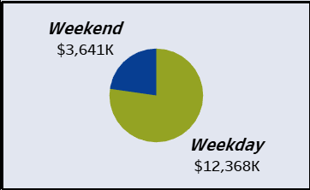
KPI 1:
Weekday Vs Weekend (order purchase timestamp) Payment Statistics:
The analysis of payment statistics based on weekday vs. weekend provides an understanding of the buying behavior of customers. This KPI answers questions like, which day of the week has the highest sales. The analysis of this KPI can help Olist to improve their weekend sales and plan promotions accordingly.
Recommendations: Clearly,Weekday % is higher than weekend’s. So valuable feedback would be: Increase sales in weekends by giving promotional iffers, attractive discounts, provide coupons for gifts etc.

Slide 5
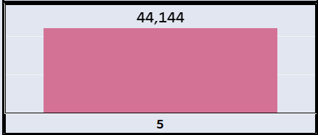
KPI 2: Number of Orders with review score 5 and payment type as credit card This KPI analyses the number of orders with a review score of 5 and payment type as credit card. This helps in understanding customer satisfaction levels and payment preferences. Olist can use this information to identify satisfied customers and encourage them to make repeat purchases.

Slide 6
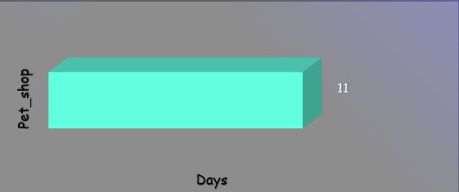
KPI 3:
Average number of days taken for order delivered customer date for pet shop
This KPI analyzes the average number of days taken for order delivered customer date for pet shop. It helps Olist in identifying areas where they can improve their delivery time and maintain customer satisfaction.

Slide 7
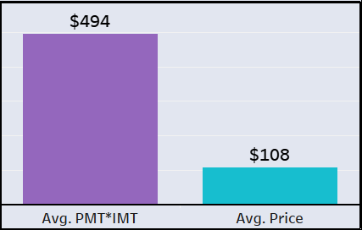
KPI 4:
Average price and payment values from customers of sao Paulo city
The analysis of average price and payment values from customers of Sao Paulo city helps in understanding the spending patterns of customers in this region. It also helps Olist in identifying high-value customers and creating targeted marketing campaigns.

Slide 8
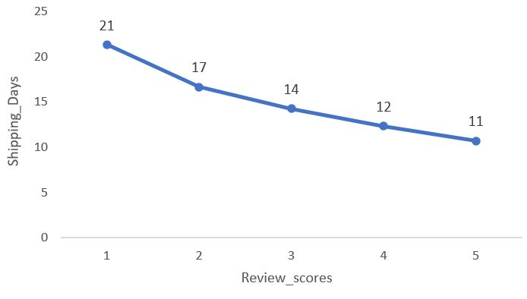
KPI 5:
Relationship between shipping days (order delivered customer date — order purchase timestamp) Vs review scores
This KPI analyzes the relationship between shipping days and review scores. It helps in understanding the impact of delivery time on customer satisfaction levels. Olist can use this information to optimize their logistics and improve their delivery time.
Recommendations: As we can conclude that ship days are interconnected to the review scores given, so, we can provide insights regarding reducing the shipping days by finding out alternate logistic methods for delivery to improve scores.

Slide 9
Suggestions
As weekdays sales is more compared to weekend so we suggest to Sell the weekend lifestyle around your product by creating content that is relevant to your target audience to increase the weekend sales.
As average review score is 4 and review score depend on shipping day (the difference between order date and delivered date) so try to reduce shipping days to improve review score.
As there is less sales in September, October and December so to improve that we suggest to start seasonal promotions like having exclusive discounts, limited-time offer, festival sales etc.
As there are only 4 types of payments we suggest to give more option to do payments which will help customers and also give some discount on debit card or voucher.

Slide 10
DASHBOARDS ON THE BASIS OF KPI USING TOOLS
EXCEL
POWER BI
TABLEAU

Slide 11
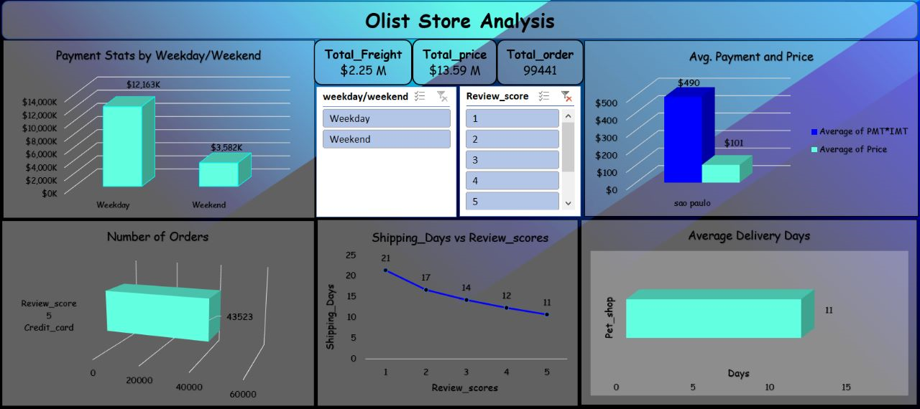
Excel Dashboard

Slide 12
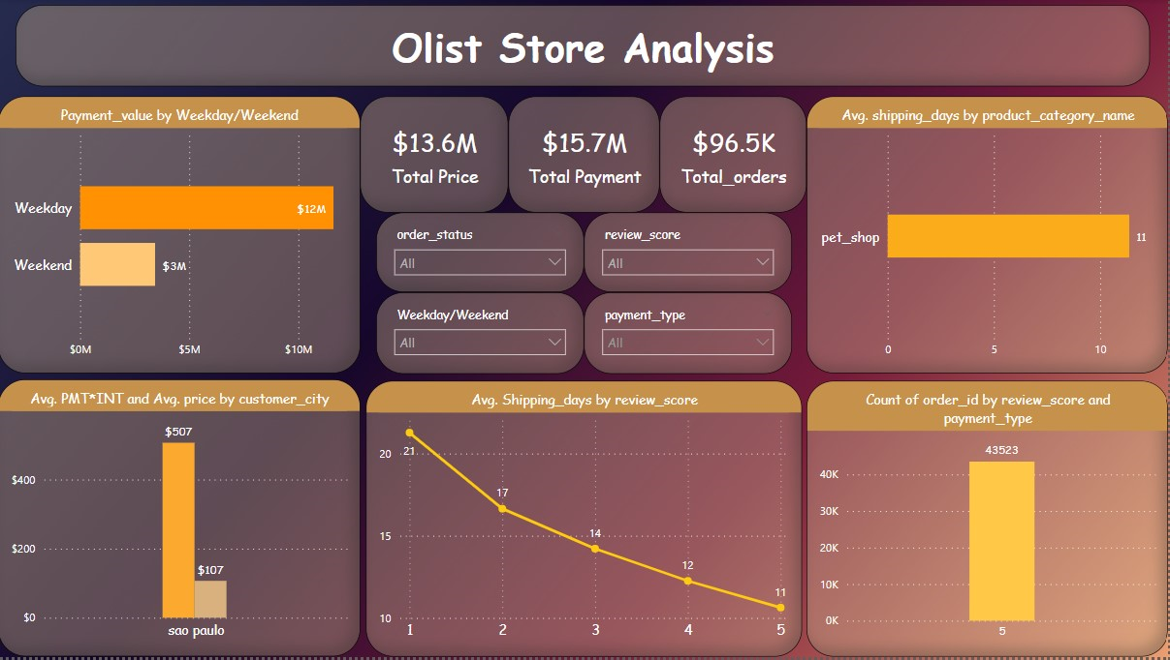
POWER BI DASHBOARD

Slide 13
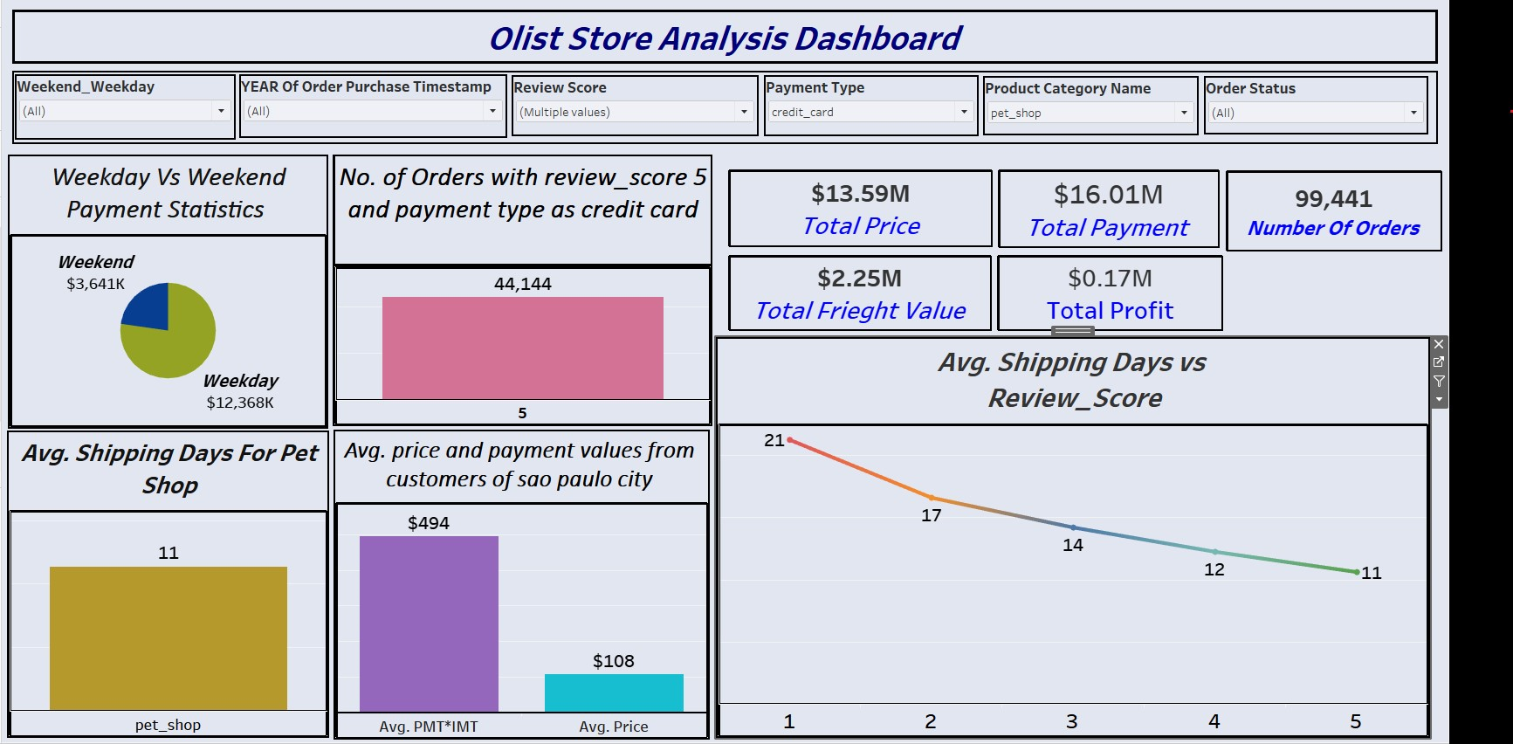
TABLEAU DASHBOARD

Slide 14
Conclusion
The Olist Store Analysis project provides valuable insights into customer behavior and payment statistics. The analysis of these KPIs helps Olist in identifying areas of improvement and creating targeted marketing campaigns. As a data analyst, I have used Excel and Power BI to clean and manipulate the dataset and create meaningful visualizations. This project serves as a great example of how data analysis can help businesses make informed decisions.

Slide 15
THANK YOU !

